Slide 1
Effects of Gun Type on the Number of Victims in Mass Shootings
Tom Bagley, Hannah Hammond, Latham Jeppson, Amber Oldroyd, Parker Short

Slide 2
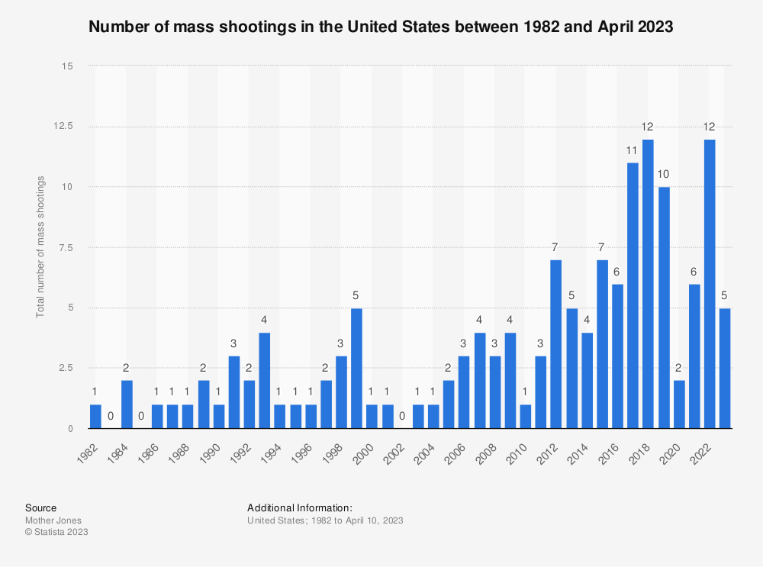

Slide 3

Notes:
Answer the question of interest. Why is this important? Context of mass shootings in America…

Slide 4
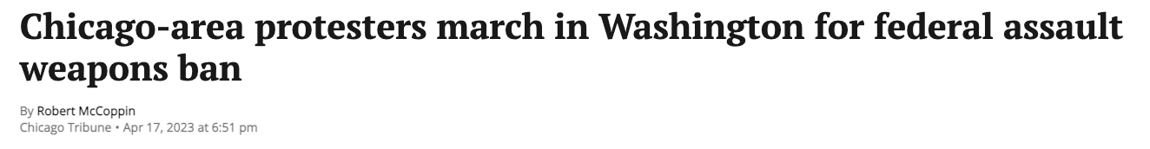

Slide 5
Data and Cleaning
Data Source - Violence Project Mass Shooter Database with 152 columns
Dropped columns that were non-numerical or had more than 10% missing values
We made dummy variables for the remaining columns:
410 Categorical/Dummy Variables
5 others: Year, Latitude, Longitude, Age, Total Firearms Brought to the Scene
We ranked firearms in order of hazard: Handgun, Shotgun, Rifle, Assault Weapon
Notes:
We chose the most dangerous gun (Assault rifle > Rifle > Shotgun > Handgun) - mention how this could be a limitation because we don’t really know; maybe we should’ve dropped them?
How many variables, missing values, merging process

Slide 6
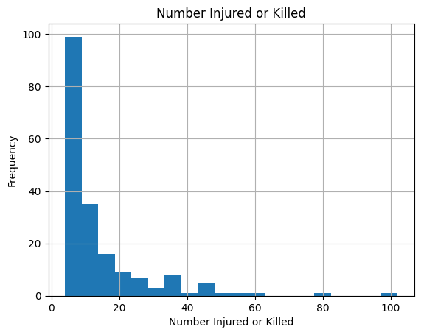
Data Visualization
Feature | Average
Signs of Being in Crisis | 0.819149
Interest in Firearms | 0.340426
Childhood Trauma | 0.351064
Isolation | 0.414894
Abusive Behavior | 0.441489
Notably Depressed Mood | 0.308511
Motive: Employment Issue | 0.212766
Parents had Mental Health Challenges | 0.111702
No Signs of Mental Illness | 0.308511
Notes:
Only a few continuous/numerical values, most dummy variables ()

Slide 7
Methods
PDS Lasso on set of polynomial features and interaction terms
Lasso on regular, cleaned dataset
Ridge
Notes:
What is the Lasso w/ Polynomial Features? What does Polynomial Features stand for?
Problem? Linearity of the data

Slide 8
Methods
 | Mean-Squared Error |  | Accuracy
Model | Training Set | Test Set | Training Set | Test Set
Lasso with PF | 4.288 | 17704.074 | 0.9761 | -0.0083
Lasso | 5867.41 | 221.934 | 0.1088 | -0.0122
Ridge | 148.064 | 17769.757 | 0.1091 | -0.0123
Notes:
What is the Lasso w/ Polynomial Features? What does Polynomial Features stand for?
Problem? Linearity of the data

Slide 9
Methods
Gradient Boosted Trees
Random Forest
PCA, then PDS Lasso

Slide 10
Methods
 | Mean-Squared Error |  | Accuracy
Model | Training Set | Test Set | Training Set | Test Set
GBT | 178.102 | 18075.363 | 0.1088 | -0.0122
Random Forest | 148.148 | 17788.606 | 0.109 | -0.013
PCA, then Lasso | 5996.118 | 17769.757 | 0.1091 | -0.0123

Slide 11
Results of OLS
Coef std err t P>|t| [0.025 0.975]
_______________________________________________________________________________________
Const 10.4588 7.316 1.430 0.155 -3.975 24.893
Shotgun 0.1912 16.763 0.011 0.991 -32.881 33.263
Rifle 2.4474 13.989 0.175 0.861 -25.152 30.047
Assault weapon 28.2667 11.947 2.366 0.019 4.697 51.837
R-squared 0.033
Adjusted R-squared 0.017
Notes:
OLS - Since ML failed and the features didn’t explain the variation in the data

Slide 12
Conclusion
Policy implications
Extensions - legality, magazine capacity, state policy
No clear solution
Notes:
We don’t want more data…

